Slide 1


Fundamentals of RM
RM System and Process
Leadership in RM
Incident Investigation
RM Tools & Challenges
RM in Industry
People & Org.
Application and Perspectives
On Becoming a
Leader in Risk Management
ENGG404 - Lecture
Chapter 4.4
The Swiss Cheese Model of a Loss Incident
(The Relationship Between Latent Causes and Loss Incidents)

Slide 2
Learning Outcomes:
Explain the basic construct and components of the Swiss Cheese Model of a loss incident.
Explain the relationship between a latent cause and a loss incident i.e. how a latent cause (a weakness in a management system element) can lead to weaknesses in the risk management program, and ultimately lead to a loss incident.
Explain how and why some workers “only have bad choices”.
Chapter 4.4 The Swiss Cheese Model of a Loss Incident
2
Notes:
2

Slide 3
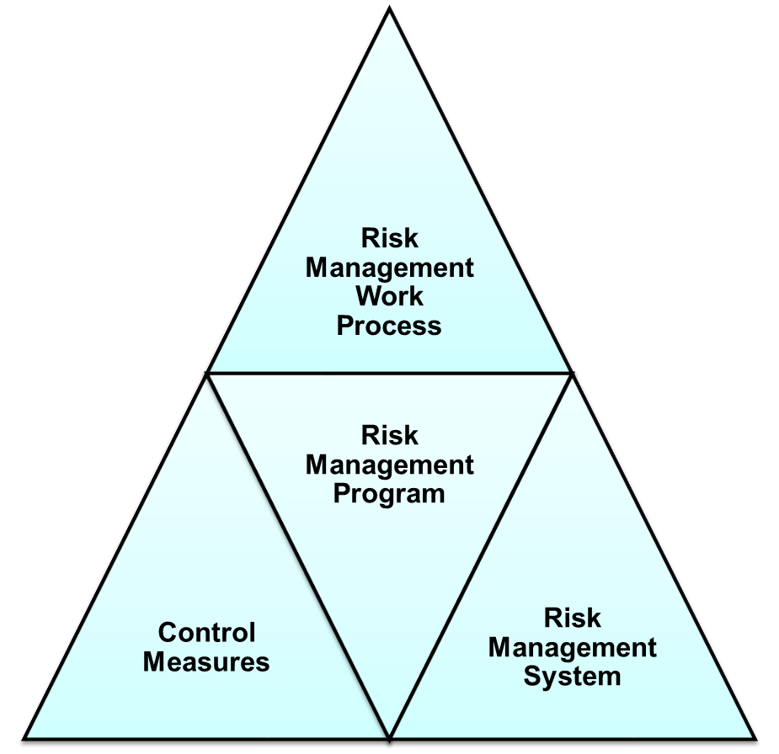
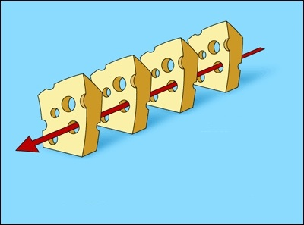
Examine The Components of the RM Program:
The Risk Management Program:
The Risk Management Work Process
Risk Management System
Control Measures
The Slices of the Swiss Cheese Model:
… depicts the RM Program and two of
its components!
Chapter 4.4 The Swiss Cheese Model of a Loss Incident
3
Notes:
3

Slide 4
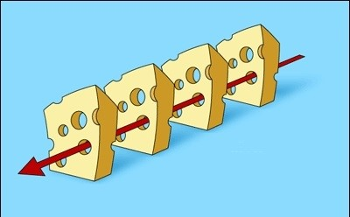
The “Swiss Cheese” Model of a Loss Incident:
Consider the block of cheese and the set of cheese slices as your
facility’s Risk Management Program.
The slices of cheese are successive safeguards to prevent a loss incident.
Planned activity and its hazards & risks …
and a successful outcome is intended.
Successful outcome?
Chapter 4.4 The Swiss Cheese Model of a Loss Incident
4
Notes:
4

Slide 5
The “Swiss Cheese” Model of a Loss Incident:
Now consider the red arrow, wherein some kind of activity is planned, with its inherent hazards and risks and with the intention of a successful outcome.
If the safeguards to manage risks are effective, then there is a successful outcome.
If the safeguards are deficient, as depicted by “holes”, an incident will occur.
Planned activity and its hazards & risks …
and a successful outcome is intended.
Successful outcome?
Chapter 4.4 The Swiss Cheese Model of a Loss Incident
5
Notes:
5

Slide 6
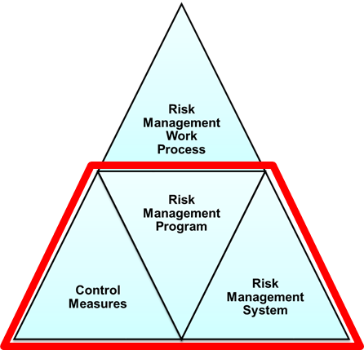
Effective Implementation of a RM Program:
The Risk Management Program is applied (1,2,3,4) to control the hazards and
reduce the risks associated with the planned activity to an acceptable level; where:
1) Risk Management System; 3) Administrative Control Measures;
2) Engineering Control Measures; 4) Work Practices.
When the risk management program is implemented effectively, i.e. all safeguards and control measures are working, then there is a successful outcome to the planned activity, and loss incidents are prevented.
1
2
Planned activity and its hazards & risks
3
X
D
4
X
X
X
Effective Implementation of a
Risk Management Program
Successful outcome
Successive levels of effective control measures
Chapter 4.4 The Swiss Cheese Model of a Loss Incident
6
Notes:
6

Slide 7
Breakdowns in Safeguards of the RM Program:
When there are weaknesses in the Risk Management Program – the program implementation is defective or ineffective – then there are breakdowns in the engineering controls, the administrative controls, and the work-practices, as represented by the holes in the cheeses slices.
It is only a matter of time (probability, likelihood, chance, luck) before all of the breakdowns in the engineering controls, administrative controls, and work practices happen at the same time – these align – and a loss incident happens.
1
2
Planned activity and its hazards & risks
3
4
D
Loss Incident
Breakdowns in safeguards (control measures),
ultimately due to latent causes.
Chapter 4.4 The Swiss Cheese Model of a Loss Incident
7
Notes:
7

Slide 8
Address Latent Causes to Restore the RM Program:
After the root cause analysis is completed and the recommendations that address the latent cause(s) are effectively implemented, then the effectiveness of the implementation of the Risk Management Program is restored, and planned activities can be undertaken with successful outcomes.
1
2
Planned activity and its hazards & risks
3
X
D
4
X
X
X
Effective Implementation of a
Risk Management Program
Successful outcome
Successive levels of effective control measures
Chapter 4.4 The Swiss Cheese Model of a Loss Incident
8
Notes:
8

Slide 9
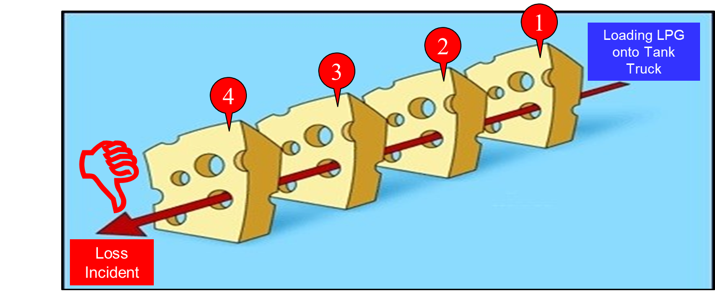
Example #1: Surmise Latent Causes at Sunrise Propane LI
Work practices: smoking while loading, running truck, not chocking the wheels, illegal truck-to-truck transfer; not recognizing risks of handling inflammable liquefied propane
Administrative Control Measures: inadequate procedures, poor training, no checklists
Engineering Control Measures: defective / lack of gas detectors / alarms system, defective / lack of deluge/sprinkler system, facility built without proper truck loading area or without storage tanks
Risk management Work Process: Hazards clearly not controlled. Were hazards even identified?
RM system - latent causes: lack of operating procedures, #8; lack of training program, #9; inadequate risk assessment program, #2; lack of maintenance program; #8; lack of design program, #7; lack of leadership commitment to operate a safe facility in accordance with legal requirements, #1.
The point: NOT to know
details about Sunrise Propane,
but to develop your skills at
aligning, even deducing, the
causes of a loss incident based
on the four components of
The Swiss Cheese Model!
Chapter 4.4 The Swiss Cheese Model of a Loss Incident
9
Notes:
9

Slide 10
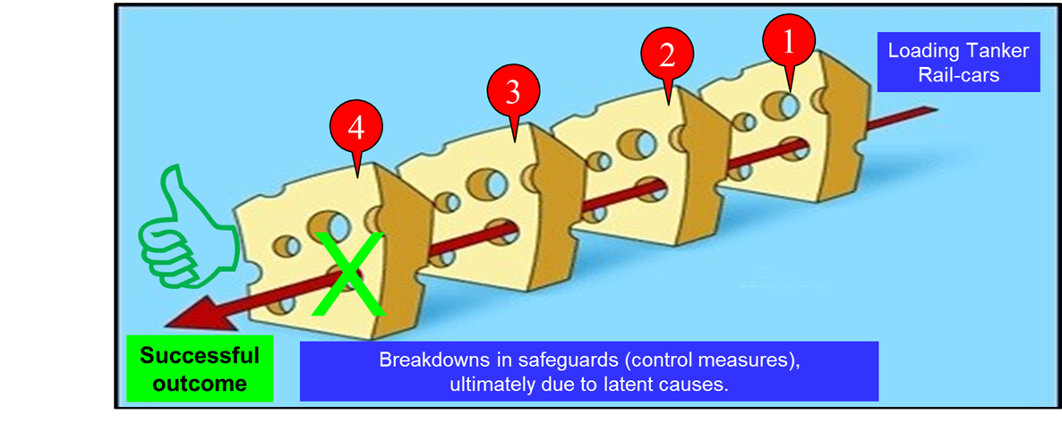
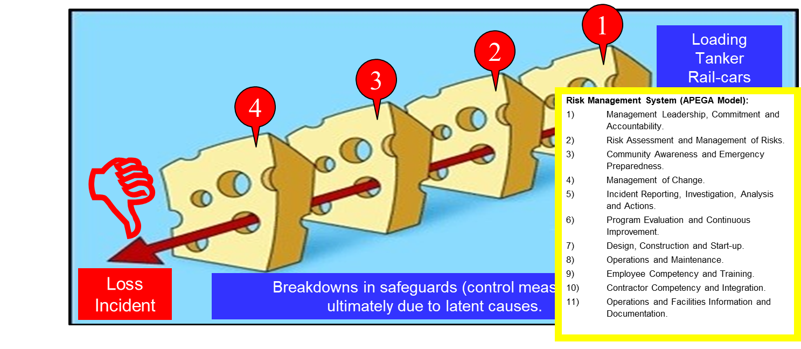
Example #2: Align Case Details with Swiss Cheese Slices
The facility: A loading operation to fill tanker rail-cars with a combustible fluid.
The loading operator routinely stood right next to the rail-car to shut off the flow of product when the rail-car was at the “full” mark. Slice #4) Work Practices
The maintenance program to maintain and repair instrumentation did not include a standard to classify “priority” repairs on critical level instrumentation. Slice #1) RME #8 O&M
It was widely known that the level switch on the rail-car was in a defective state i.e. could not detect “full” condition. Slice #2 Engineering Controls
The maintenance schedule prioritized repairs based on “critical” and pushed out the repair of the level switch. Slice #3) Administrative Controls
Bonus discussion point:
What if the worker is called away or interrupted
while watching the rail-car filling up?
Chapter 4.4 The Swiss Cheese Model of a Loss Incident
10
Notes:
10

Slide 11
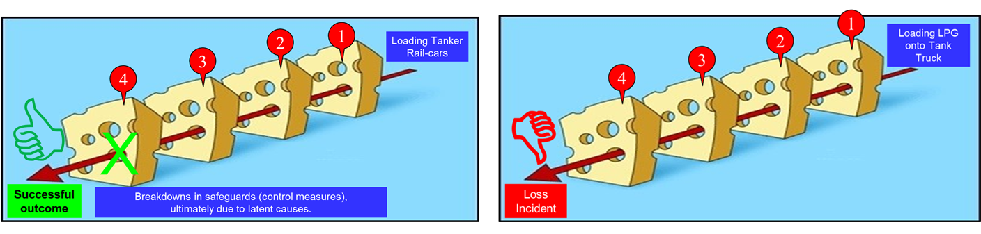
Example #3: “Only Bad Choices” and Setting Up for Failure
Consider the two graphics below:
Both of which are at the same organization with exactly the same risk management system and program!
The difference being two different workers … with two different outcomes!
On the left “successful outcome”, the worker:
Knows that the “system has failed” and
Takes specific actions to prevent something bad from happening.
On the right “”loss incident”, the worker:
Is not fully aware that the “system has failed” and
Does not know that they must take specific action!
Has “only bad choices” because the RM S&P are ineffective and have set up the worker for failure!
Chapter 4.4 The Swiss Cheese Model of a Loss Incident
11
Notes:
11

Slide 12
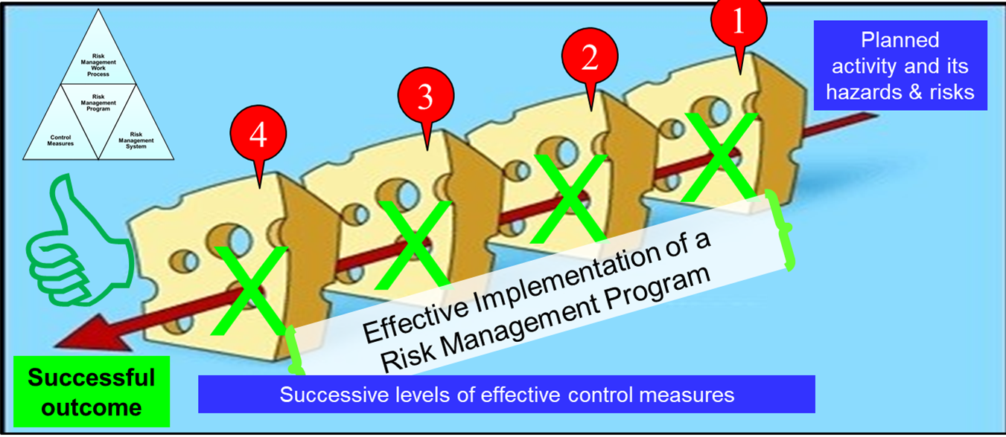
Summary of Chapter 4.4 and Key Lessons:
The Construct of the Swiss Cheese Model:
Depicts the Risk Management Program.
The 4 successive barriers of the Swiss
Cheese Model to a loss incident (in
order of effectiveness) are:
RM System,
Engineering Control Measures,
Administrative Control Measures, and
Work Practices.
Latent causes are always linked to a relevant management system element.
Key Lesson:
The Swiss Cheese Model depicts how a latent cause can lead to weaknesses (holes) in other parts of the RM Program, and how these weaknesses can ultimately lead to a loss incident.
Workers “only have bad choices” when the RM system and program are not effectively implemented.
Chapter 4.4 The Swiss Cheese Model of a Loss Incident
12
Notes:
12

